Slide 1
Light-Braker
Where Safety and Innovation Meet

Slide 2
Presentation Outline
Problem
Idea
Concept
Risk Mitigation
Testing
Timeline
Bill of Materials
Summary

Slide 3
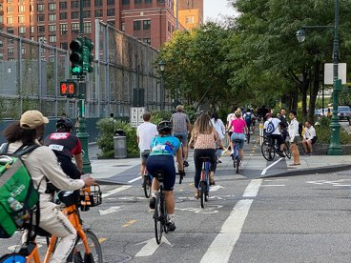
Problem
Most bikes don’t have a brake light to indicate that they are braking
Congested bike lanes can reduce the rider’s reaction time leading to crashes
Solution
Create a brake light that lets trailing riders know you are braking and how fast

Slide 4
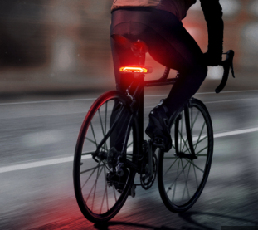
Introducing the Dynamic Brake Light
Increases in brightness the quicker you are slowing down
Uses an accelerometer to take acceleration inputs
As negative acceleration increases, power output to the brake light increases
Added LCD display and distance tracking

Slide 5
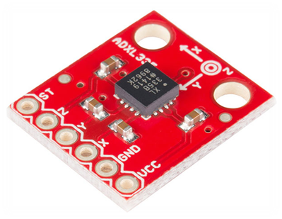
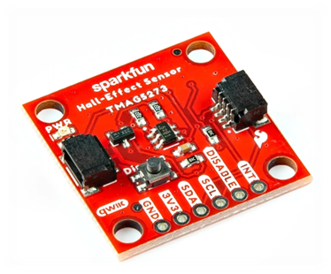
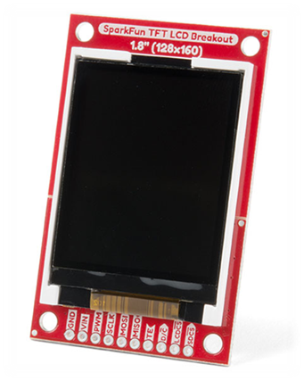
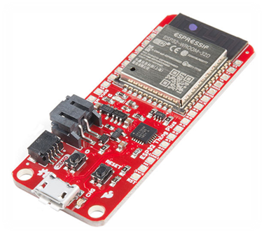
Introducing the Dynamic Break Light
Accelerometer ADXL335
Hall-Effect Sensor
Thing Plus ESP32
TFT LCD Breakout

Slide 6
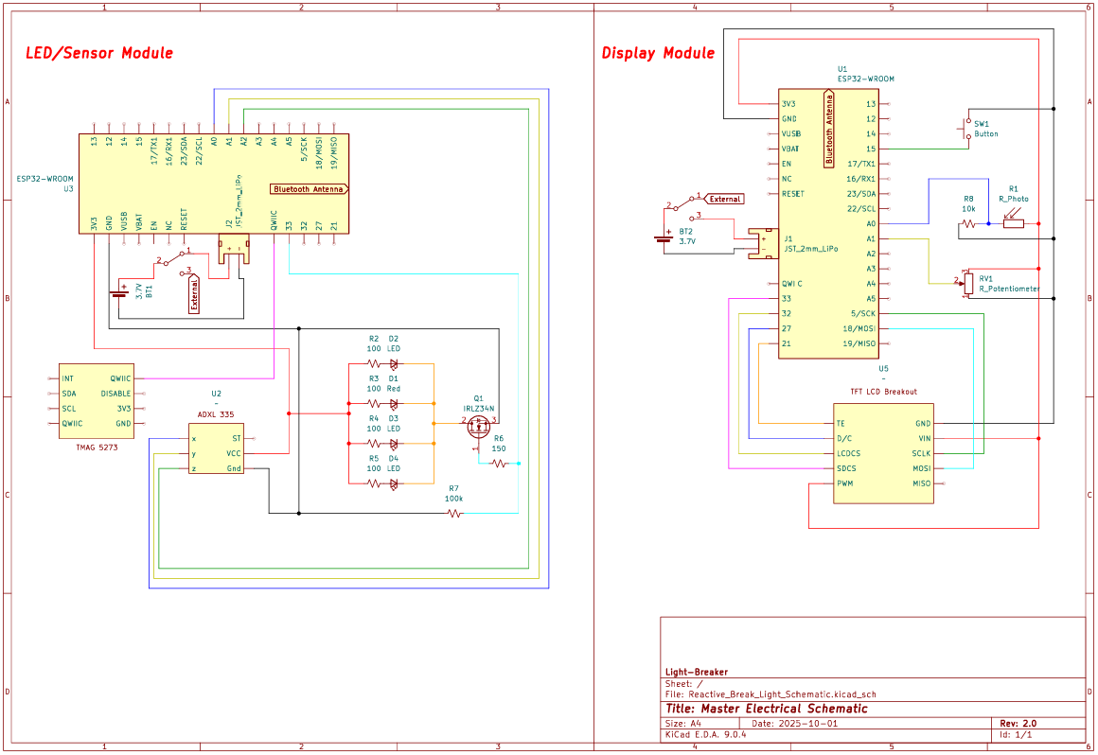
Electronics
Why the ESP32 platform over the UNO?
Size
Processing Power
Bluetooth and Wi-fi Integration
TFT LCD Breakout
similar to the TI-84 PLUS CE display
customizable interface
SparkFun HyperDisplay library
Sensors provide analog readings, creating room for fine tuning.

Slide 7
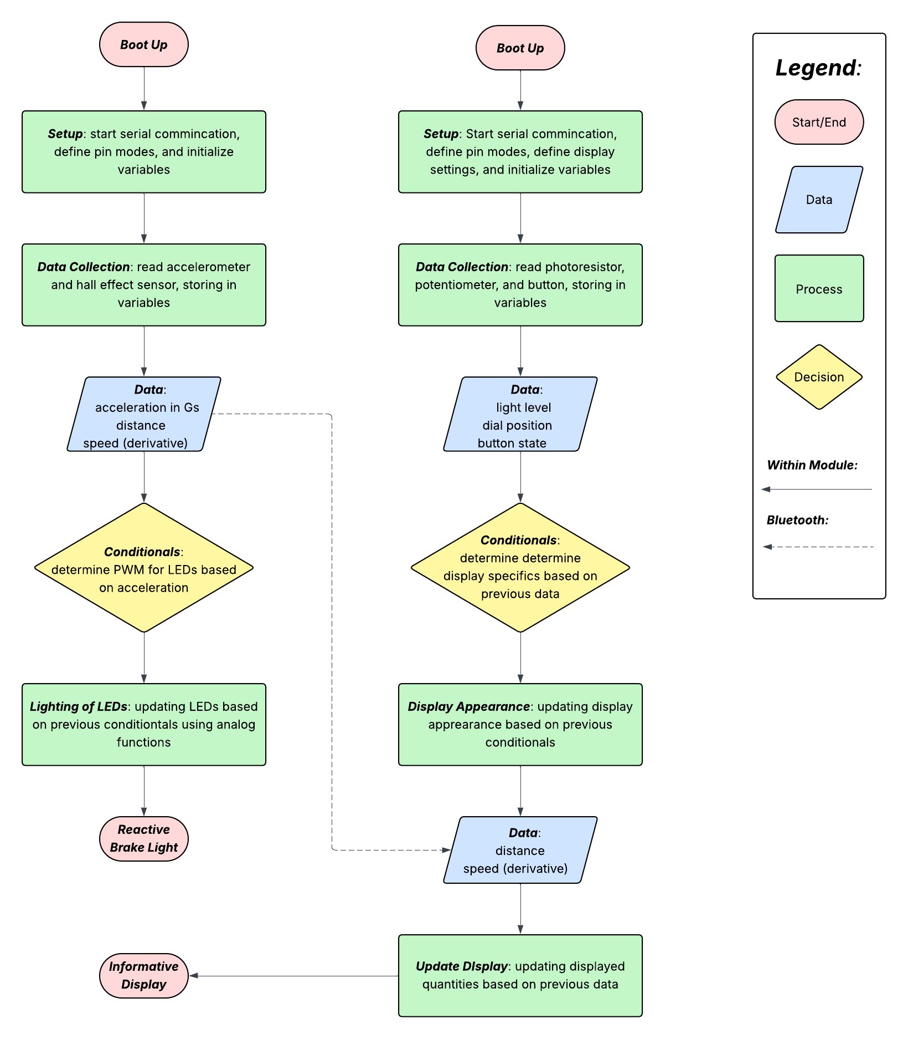
Code
Arduino IDE
easy to learn
good user interface
variety of documented libraries
  Espressif esp32 library
  SparkFun HyperDisplay library
  ArduinoBLE library
Issues:
esp32 specific analog functions
  ledcWrite() alternative to analogWrite()
3.x.x verions of Espressif esp32 library broke the defining of ledc functions

Slide 8
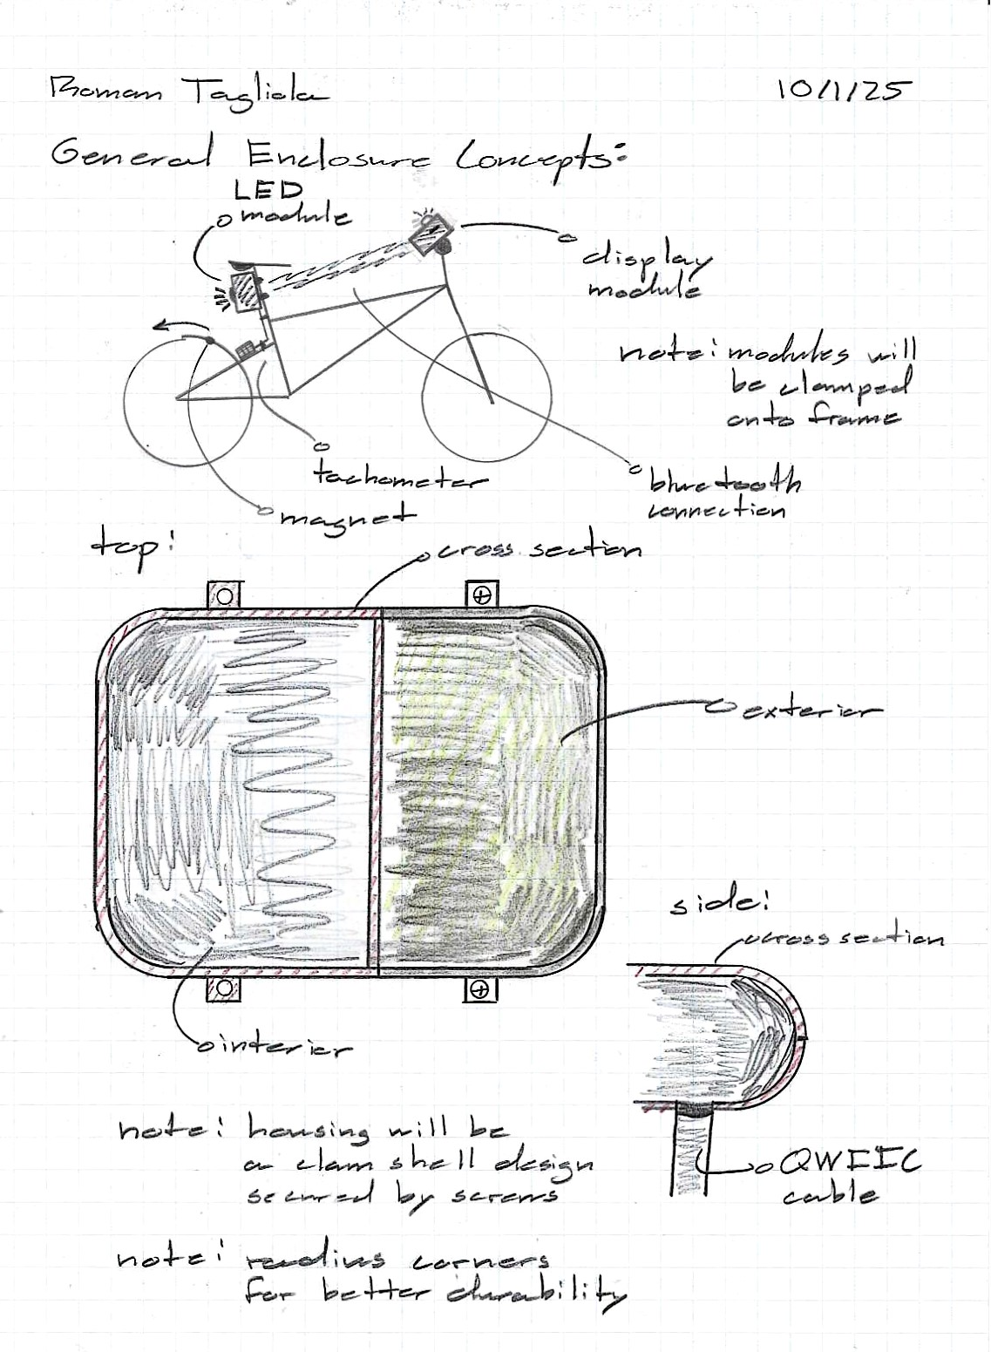
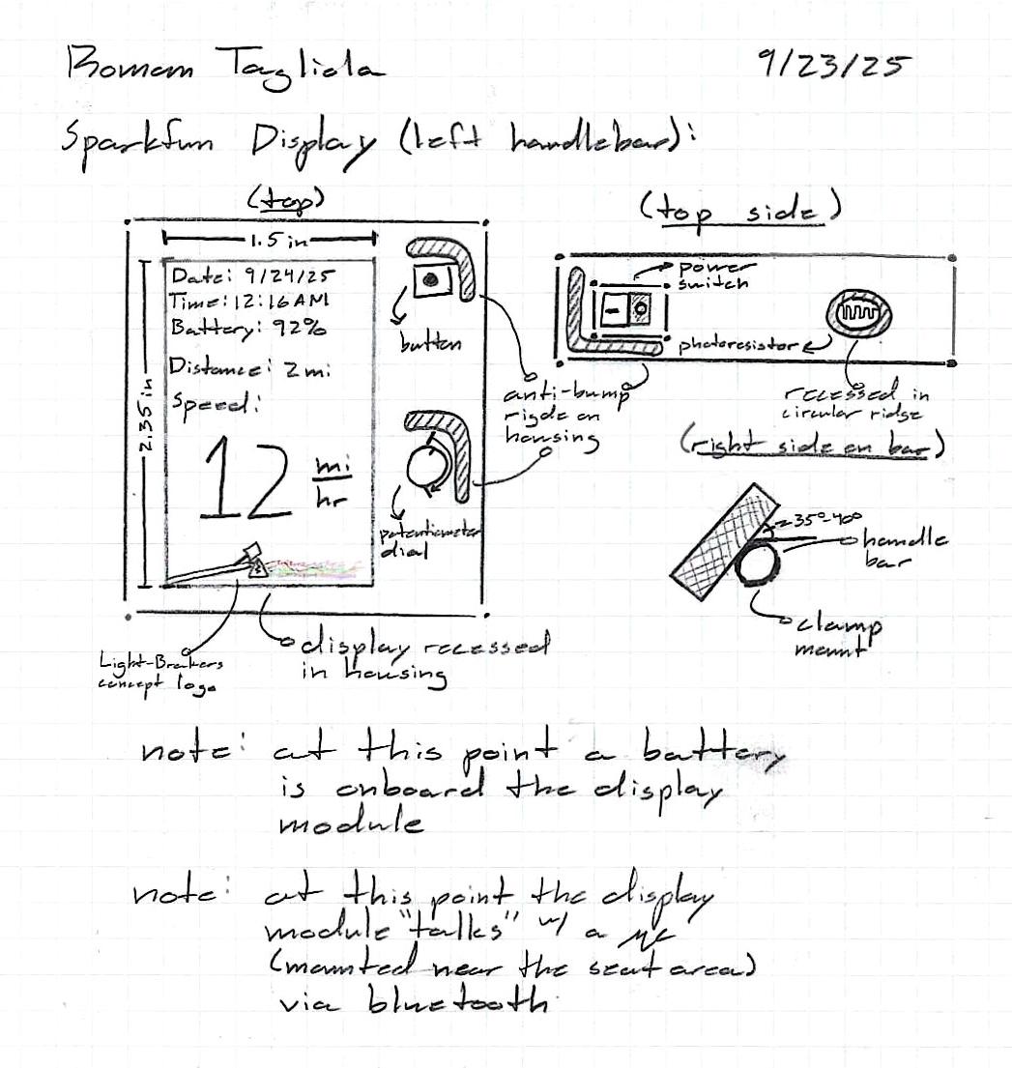
Electrical Enclosures
Software:
Onshape (Cloud)
PrusaSlicer
3D Printing:
Prototyping: PLA
Expo: Nylon Filament

Slide 9
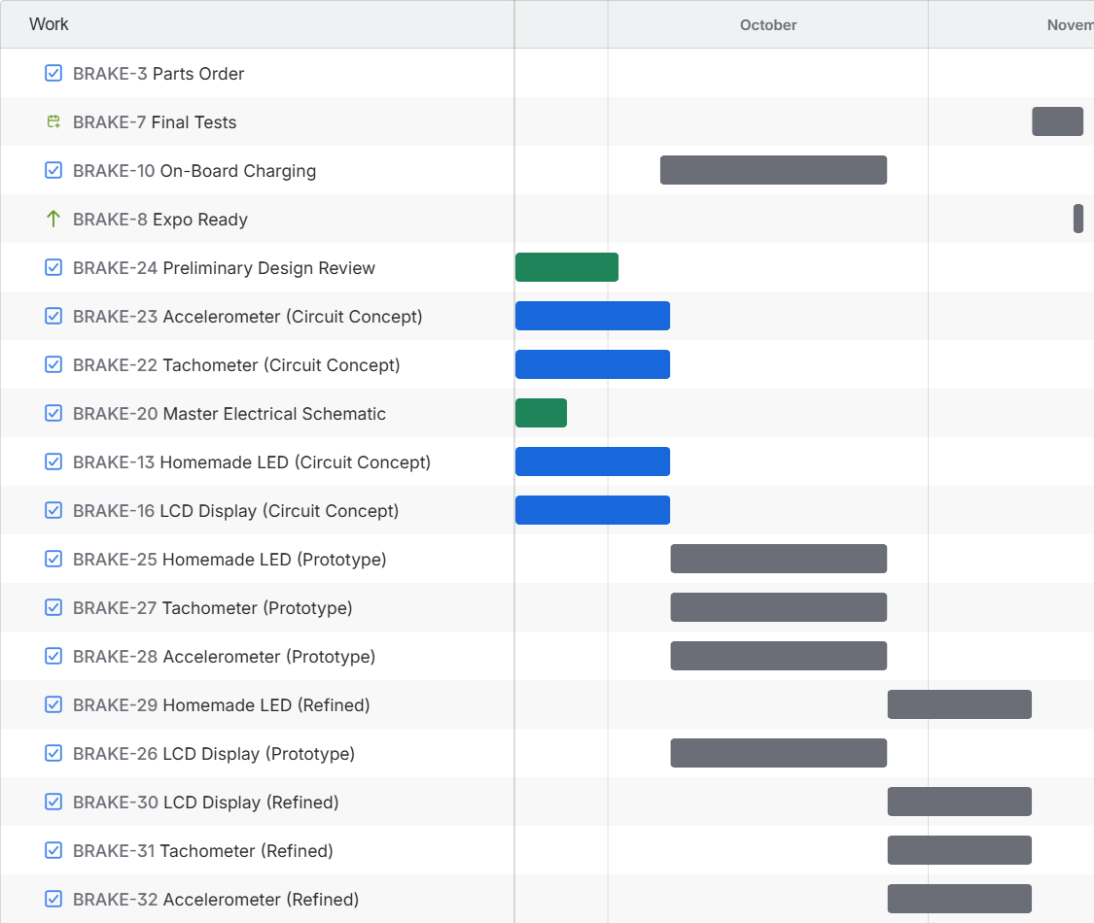
Timeline
Responsibilities:
each teammate responsible for one area of the project
  Mitchell: accelerometer
  Jacob: LED array
  Rowan: tachometer
  Roman: LCD display
Jira:
used to keep track of tasks, expenses, and deadlines
Gantt Chart

Slide 10


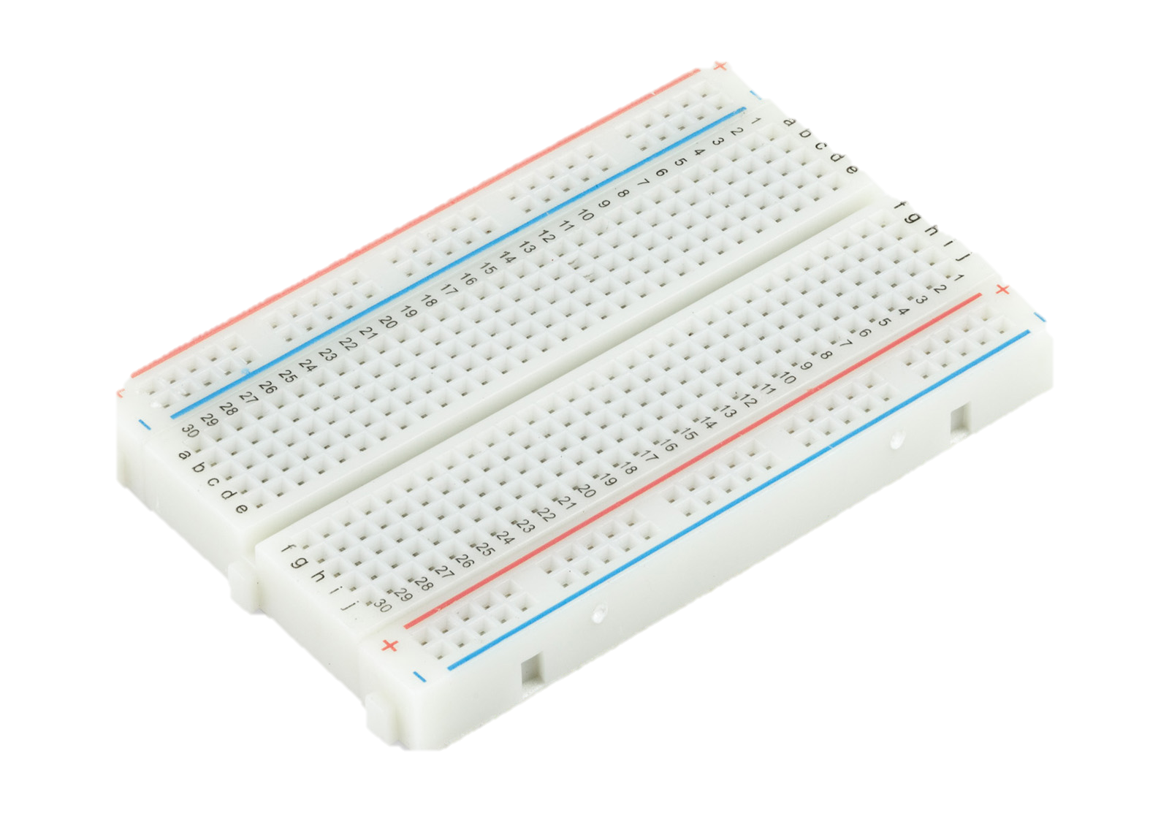
Testing Plan
Integration and Design:
be resourceful.
use amenities provided to us
Craft a brand through seamless design. This is an expo!
Hardware:
Ensuring that microcontrollers integrate well with our system
LCD Screen
Accelerometer
Hall Effect Sensor
Bluetooth Communication
Batteries
Test components on a breadboard. Spend time doing the MATH!
Software:
capable of supporting the hardware
  ensuring everyone is on the same page
  testing code before soldering

Slide 11
Risk Mitigation
Potential Risk | Our Plan
Not having enough power | To use an external supply that goes into the Arduino Board
Wires and connection coming loose due to bumps and shaking of the bicycle | Create absorbent casings that minimize the bumps, maintaining a strong connection and solder our parts.
Errors in coding when it comes to the luminosity of the lights, LCD Display, Accelerometer, and Hall-Effect Sensor | Preprogram all our components on a breadboard before attaching it to the bike, and using trial and error to resolve any errors

Slide 12
Bill of Materials
Item Name | Price (USD) | Where? | Importance
SparkFun Triple Axis Accelerometer Breakout | 19.50 | Amazon | Measures our acceleration, allowing us to know when we are slowing down.
SparkFun Linear 3D Hall-Effect Sensor | 7.11 | Amazon | Magnetic field sensor to determine the distance travelled on the bike
LED – Super Bright Red (25 Pack) | 4.75 | SparkFun Electronics | Makes up or brake light on the back of the bike
SparkFun Qwiic Cable Kit | 12.95 | SparkFun Electronics | Allows us to wire things faster with less error
SparkFun Capacitor Kit | 11.50 | SparkFun Electronics | Allows us to more precisely control the thresholds
SparkFun TFT LCD Breakout – 1.8" (128x160) | 34.95 | SparkFun Electronics | This is our digital display for our speed, distance, etc.
2x SparkFun Thing Plus – ESP32 WROOM (Micro-B) | 24.95 per 49.90 total | SparkFun Electronics | These are the core of our circuit and project

Slide 13
Summary
We've identified an issue and have developed a solution
Our dynamic brake light is intended to reduce bike accidents
Through our planned testing and navigating risks our device will be optimized
Questions?

